Slide 1
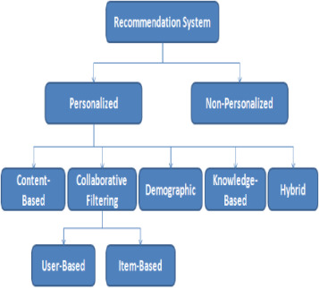

Recommendation System

Slide 2
Recommender Systems
System that produces individualized recommendations as output or has the effect of guiding the user in a personalized way to interesting or useful objects in a large space of possible options. (Burke 2002)
A personalized information filtering technology used to either predict whether a particular user will like a particular item (prediction problem) or to identify a set of N-items that will be of interest to a certain user (top-N recommendation problem). (Deshpande and Karypis(2004))

Slide 3
Recommender Systems Goals
The primary goal of a recommendation system is to increase revenue for the merchant.
The common operational and technical goals of recommender systems are as follows:
Relevance: recommend items that are relevant to the user at hand.
Novelty: the recommended item is something that the user has not seen in the past.
Serendipity: the items recommended are somewhat unexpected. Serendipity is different from novelty in that the recommendations are truly surprising to the user, rather than simply something they did not know about before.
Diversity: Increasing recommendation diversity

Slide 4
Popular Recommendation Engines
Amazon.com
Amazon.com claims that 35% of products sales result from recommendations.
Netflix.com
About 66% of movies rented in Netflix.com are recommended
Google.com
Google News Recommendations generate 38 % more click-throughs.
Facebook.com
Friends recommendation

Slide 5
Recommender Systems Models
Prediction version of problem:
Predict the rating value for a user-item combination.
For m users and n items, an incomplete m × n matrix or training data (or observed) is available, indicating user preferences for items.
The missing (or unobserved) values are predicted using this training model.
This problem is also referred to as the matrix completion problem.
Ranking version of problem:
Recommend the top-k items for a particular user.
This problem is also referred to as the top-k recommendation problem.

Slide 6
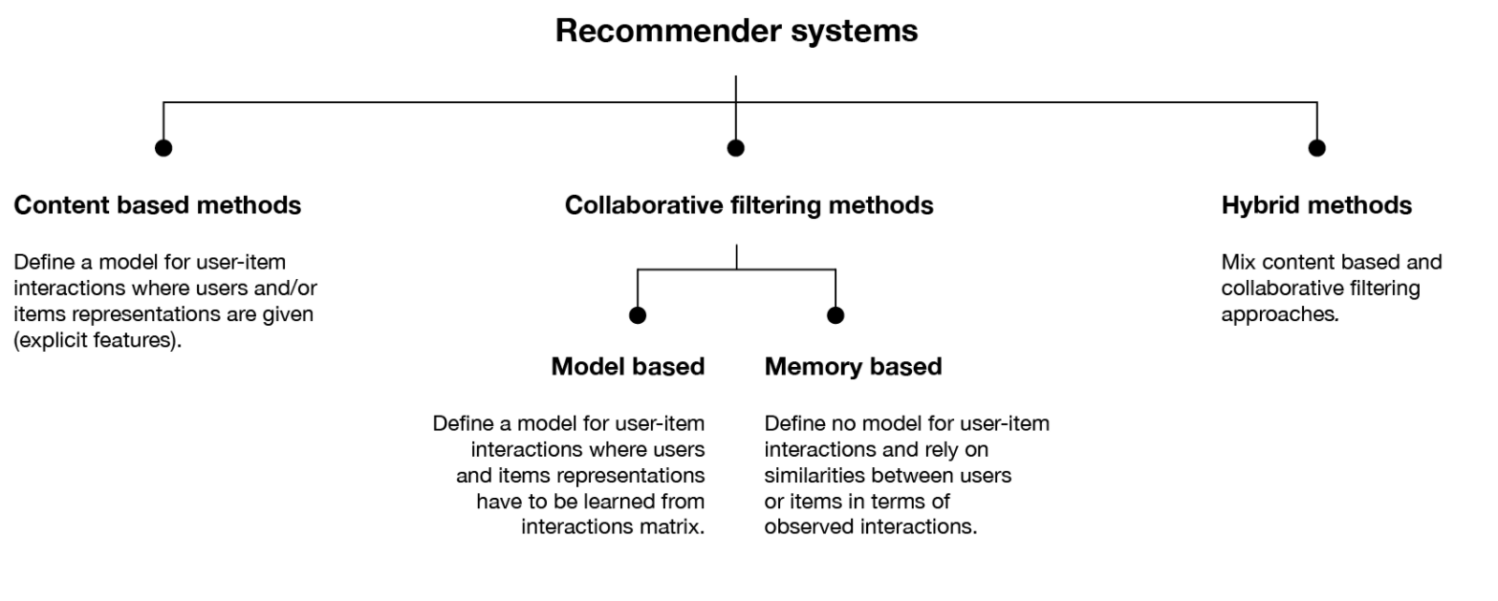
Recommender Systems types

Slide 7
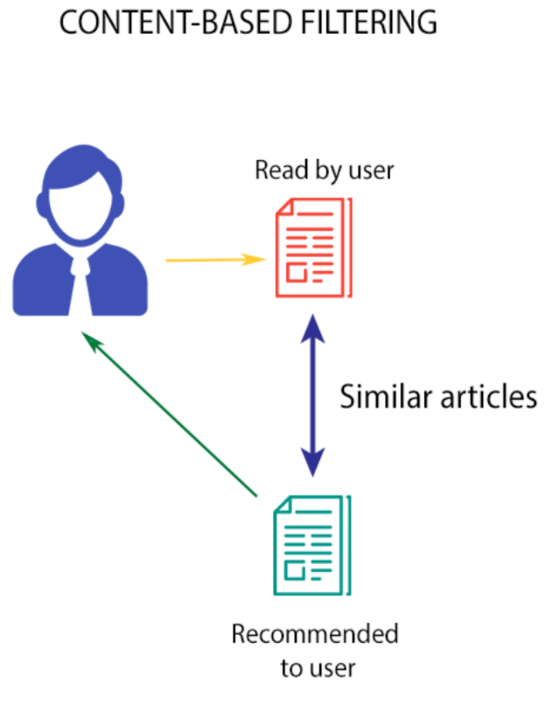
Content-based filtering algorithms
Content-based filtering algorithms
Uses the information derived from documents or item features (eg. terms or attributes).
It uses a set of attributes, which describes the items and recommends other items like those that exist in the user's profile.
This way, the cold start problem for new items and new users are alleviated, if users prefer items that are similar in content to those they have already chosen.
However, the pitfall is that there is no diversity in the recommendations. That is, the user gets recommendations that are very familiar to her, since the recommended items are like those in her item profile

Slide 8
Content-based filtering algorithms
Content-based (CB) techniques
Name | Short description | Advantages | Disadvantages | Usefulness
Case-based reasoning | Assumes that if a user likes a certain item, (s)he will probably also like similar items. Recommends new but similar items. | – No content analysis – Domain-independent – Quality improves over time | – New user problem – Overspecialisation – Sparsity – Cold-start problem | – Keeps learner informed about learning goal – Useful for hybrid RS
Attribute-based techniques | Recommends items based on the matching of their attributes to the user profile. Attributes could be weighted for their importance to the user. | –No cold-start problem –No new user I new item problem –Sensitive to changes of preferences –Can include non-item related features –Can map from user needs to items | –Does not learn –Only works with categories –Ontology modeling and maintenance is required – Overspecialisation | – Useful for hybrid RS – Recommendation from the beginning

Slide 9
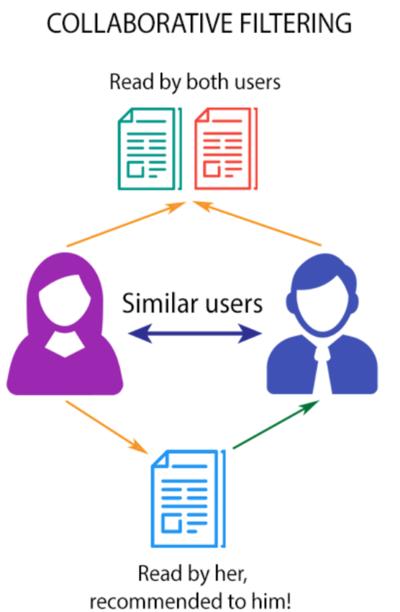
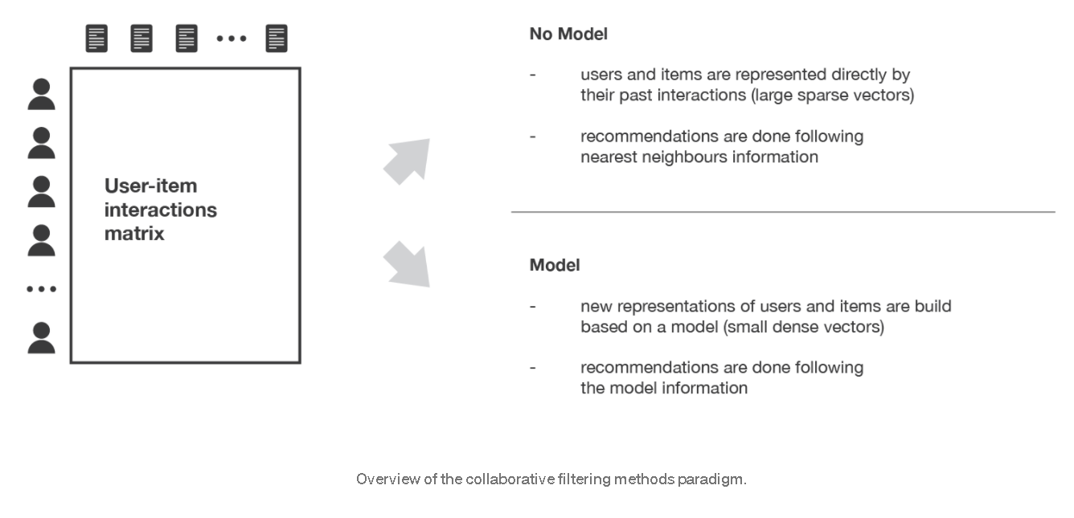
Collaborative filtering algorithms
Collaborative filtering algorithms:
Recommend items to the target user, that have been rated highly by other users with similar preferences and tastes.
”Customers who bought item x also bought item y.”
Suffer from the “cold start problem”:

Slide 10
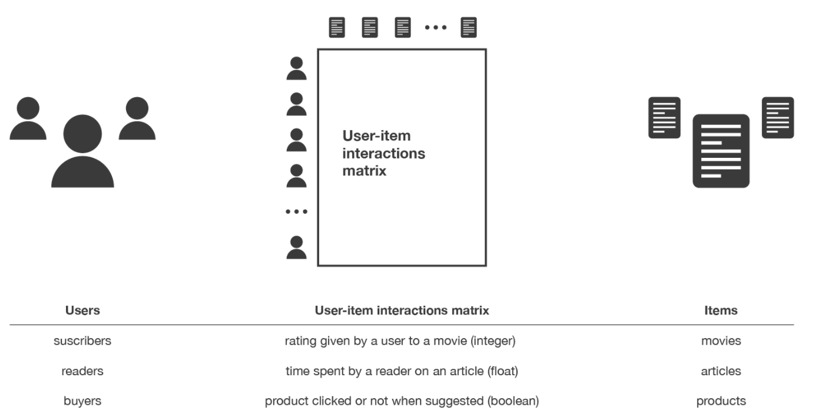
Collaborative filtering algorithms
Collaborative filtering (CF) techniques
Name | Short description | Advantages | Disadvantages | Usefulness for
User-based | Users that rated the same item similarly probably have the same taste. Based on this assumption, this technique recommends unseen items already rated by similar users. | – No content analysis – Domain-independent – Quality improves over time – Bottom-up approach – Serendipity | – New user problem – New item problem – Popular taste – Scalability –Sparsity – Cold-start problem | – Benefits from experience –Allocates learners to groups (based on similar ratings)
Item-based | Focus on items, assuming that items rated similarly are probably similar. It recommends items with highest correlation (based on ratings to the items). | – No content analysis – Domain-independent – Quality improves over time – Bottom-up approach – Serendipity | – New item problem – Popular taste – Sparsity – Cold-start problem | – Benefits from experience
Stereotypes or demographics | Users with similar attributes are matched, then recommends items that are preferred by similar users (based on user data instead of ratings). | – No cold-start problem – Domain-independent –Serendipity | – Obtaining information –Insufficient information –Only popular taste –Obtaining metadata information –Maintenance ontology | –Allocates learners to groups –Benefits from experience –Recommendation from the beginning of the RS

Slide 11
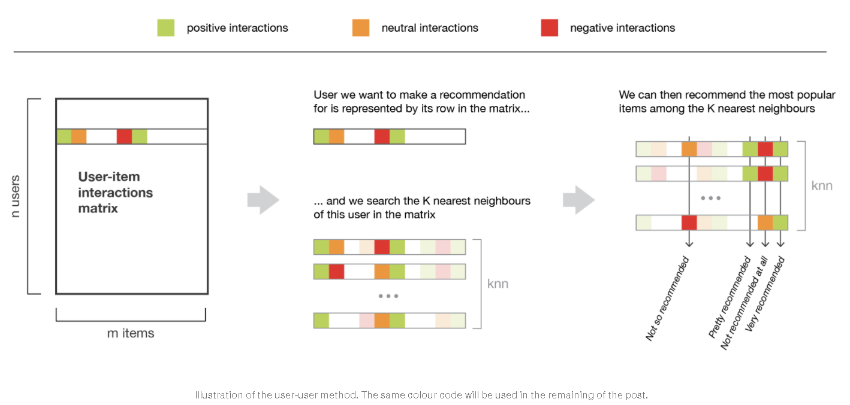
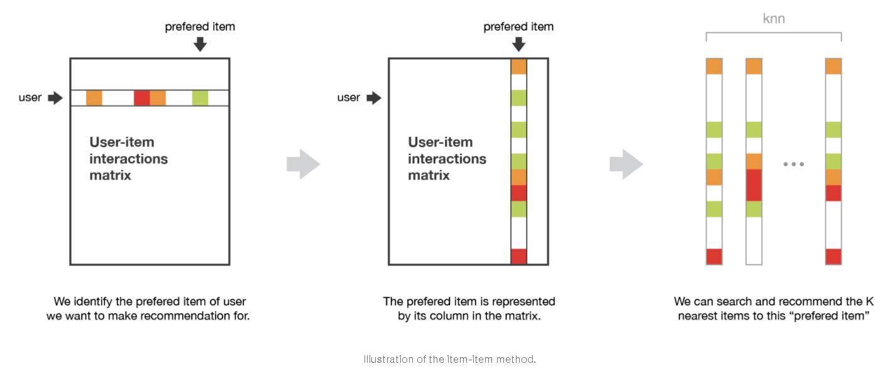
Collaborative filtering algorithms
Comparing user-based and item-based collaborative filtering:
The user-user method is based on the search of similar users in terms of interactions with items. As, in general, every user have only interacted with a few items, it makes the method pretty sensitive to any recorded interactions (high variance). On the other hand, as the final recommendation is only based on interactions recorded for users similar to our user of interest, we obtain more personalized results (low bias).
Conversely, the item-item method is based on the search of similar items in terms of user-item interactions. As, in general, a lot of users have interacted with an item, the neighborhood search is far less sensitive to single interactions (lower variance). As a counterpart, interactions coming from every kind of users (even users very different from our reference user) are then considered in the recommendation, making the method less personalized (more biased). Thus, this approach is less personalized than the user-user approach but more robust.

Slide 12
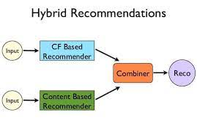
Hybrid algorithms
Hybrid algorithms
Combine Collaborative filtering with Content-based filtering.
The combination of content with rating data helps capture more effective correlations between users or items, which yields more accurate recommendations.

Slide 13
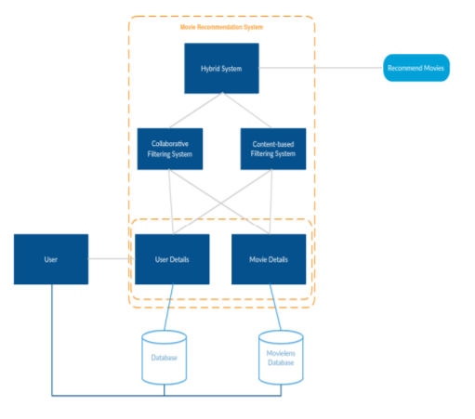
Recommendation system for youtube
We propose to build a hybrid model with weighed average of collaborative filter and content-based recommendation engine

Slide 14
References
Introduction to recommender systems | by Baptiste Rocca | Towards Data Science
45530.pdf (googleusercontent.com)
https://www.ijcai.org/Proceedings/16/Papers/339.pdf
https://towardsdatascience.com/introduction-to-recommender-systems-6c66cf15ada
https://towardsdatascience.com/creating-a-hybrid-content-collaborative-movie-recommender-using-deep-learning-cc8b431618af
https://www.youtube.com/watch?v=_hf_y-_sj5Y&list=PLZoTAELRMXVN7QGpcuN-Vg35Hgjp3htvi
https://youtube.com/playlist?list=PL14gG-x1vllBKJqEqta-j1zmcX0YLg3jY

